Slide 1

CS574 Object-Oriented Analysis & Design
CS574: Use Cases
We want to eventually produce an OO design for an application that we will be using as an example throughout the entire semester.
Our first step will be to learn about “use cases.”

Slide 2
CS574 Object-Oriented Analysis & Design
Use Cases (cont.)
In this lecture we will look at a way to write use case text/descriptions. (See the chapters in the textbook about use cases.)
The next slide gives a list of requirement for an Internet Bookstore system – not the application whose design we want to develop, but a good example for understanding use cases.
The following slides explain a bit more about the Internet bookstore and give examples of a number of the Internet bookstore use case descriptions in the desired format.

Slide 3
Internet Bookstore Requirements
The bookstore shall accept orders over the internet
The bookstore shall maintain a list of accounts for up to 1,000,000 customers
The bookstore shall provide password protection for all accounts
The bookstore shall provide the ability to search the master book catalog
The bookstore shall provide a number of search methods on that catalog, including search by author, search by title, search by ISBN number, and search by keyword
The bookstore shall provide a secure means of allowing customers to pay by credit card
The bookstore shall provide a secure means of allowing customers to pay via purchase order
The bookstore shall provide a special kind of account that is pre-authorized to pay via purchase order
The bookstore shall provide electronic links between the Web and database and the shipping fulfillment center
The bookstore shall provide electronic links between the Web and database and the inventory management system
The bookstore shall maintain reviews of books and shall allow anyone to upload review comments
The bookstore shall maintain ratings on books based on customer inputs

Slide 4
CS574 Object-Oriented Analysis & Design
Actors
The “actors” in a use case-style description of a software system are all the people and all the outside hardware and software systems with which the system interacts.

Slide 5
CS574 Object-Oriented Analysis & Design
Actors
  Some of the actors for the Internet Bookstore are:
    the (potential) customer
    probably the shipping fulfillment center worker (see the requirements document)
    possibly the web sites belonging to various shipping companies like USPS, UPS, DHL, etc., i.e., if shipping fulfillment center workers do such things as requesting pickups and checking on deliveries over the Internet.
    probably the inventory management worker
    very likely, various types of administrative employee

Slide 6
CS574 Object-Oriented Analysis & Design
Internet Bookstore Use Cases
In this part of the lecture we will use Internet Bookstore use cases to introduce the style that we will be using for use case descriptions for the rest of the course.
The only actor with which we will be concerned here is the one that we called “User” earlier in the lecture.
The only use cases with which we will be concerned are those whose titles are listed on the next slide. That is, we will not consider any (additional) actors or use cases that relate to either shipping fulfillment or inventory management
Of course complete analysis & design of the Internet Bookstore application requires that all actors and use cases be dealt with.

Slide 7
CS574 Object-Oriented Analysis & Design
Internet Bookstore Use Cases
Open Account
Log In
Search by Author
Browse List of Books
Edit Content of Shopping Cart
Check Out
Track Recent Orders
Cancel Order

Slide 8
Use Case Descriptions (cont.)
CS574 Object-Oriented Analysis & Design
The part of a use case description that relates what happens when everything goes right is called the “basic course” or the “sunny day course”.
The part of a use case description that relates what happens when something goes wrong is called an “alternate course” or a “rainy day course.”
The distinction between “basic course” and “alternate course” leaves out one possibility; do you see what it is?
The next slide shows the basic course of the Internet Bookstore’s Open Account use case in the style that we will be using.

Slide 9
CS574 Object-Oriented Analysis & Design
Open Account Use Case:
Basic Course
Basic Course
The system displays the New Account Page. The Customer types his or her name, an e-mail address, and a password (twice), and then presses the Create Account button. The system ensures that the Customer has provided valid data and then adds an Account to the Master Account Table using that data. Then the system returns the Customer to the Home Page

Slide 10
Open Account Use Case:
Basic Course (cont.)
CS574 Object-Oriented Analysis & Design
As indicated on a previous slide, a use case’s “basic course” is a description of how the relevant actor(s) and the application interact when / if everything goes right e.g., in this case if the customer, attempting to create a new account:
  types his/her name
  types a syntactically valid email address
  types a sufficiently long password
  types exactly the same password for a second time
  has typed a name and an email address that don’t already correspond to an Internet Bookstore account

Slide 11
Open Account Use Case:
Alternate Courses
CS574 Object-Oriented Analysis & Design
The next slide shows what look to be five different alternate courses for the Open Account use case.
Read the next slide carefully to see the style that we’ll be using to document alternate courses.

Slide 12
CS574 Object-Oriented Analysis & Design
Alternate Courses
If the Customer did not provide a name, the system displays an error message to that effect and prompts the Customer to type a name.
If the Customer provided an email address that's not in the correct form, the system displays an error message to that effect and prompts the Customer to type a different address.
If the Customer provided a password that is too short, the system displays an error message to that effect and prompts the Customer to type a longer password.
If the Customer did not type the same password twice, the system displays an error message to that effect and prompts the Customer to type the password correctly the second time.
If the account is already in the master account table, notify the user.
Open Account Use Case: Alternate Courses

Slide 13
Open Account Use Case: Alternate Courses
CS574 Object-Oriented Analysis & Design
As indicated a few slides back, a use case’s “alternative courses” are descriptions of how the application (system) reacts when the actor doesn’t do “the right thing,” e.g., in this case if the customer, attempting to create a new account:
  doesn’t type a name; i.e., leaves the name box empty
  and / or types a syntactically invalid email address
  and / or types an insufficiently long password
  and / or doesn’t type exactly the same password for a second time
  and / or types a name and an email address that already correspond to an existing Internet Bookstore account

Slide 14
Alternate Courses (cont.)
CS574 Object-Oriented Analysis & Design
A few slides back we suggested that there appear to be five alternate courses.
There are actually 2⁵-1 = 32-1 = 31 alternate courses because:
  there are 5 independent binary outcomes that are under the user’s control:
    valid name vs. invalid name
    valid email address vs. invalid email address
    valid password vs. invalid password
    identical passwords vs. non-identical passords
    new name and email address vs. name and email address corresponding to existing account
  So, there are 2⁵ ⁼ 32 different possible outcomes, only one of which is the basic course
  So there are 31 different possible alternate courses
But, when there are n independent (sequentially tested) binary outcomes then we will always write the alternate courses as a list of n elements, each starting with an “if” as we did two slides back.

Slide 15
Alternate Courses (cont.)
CS574 Object-Oriented Analysis & Design
A serious cause of software development failure is failure to identify and document all alternate courses of every use case
An equally serious cause of software development failure is basic and alternate courses written in incomplete / unclear / ambiguous English – or whatever language is being used
So, be very careful about these two issues and review your work multiple times before considering it to be done. (If we were working in teams, it would be best to have multiple team members check for the two issues listed above.)

Slide 16
More on Use Cases
CS574 Object-Oriented Analysis & Design
In some approaches to OOA&D, use cases are at a higher, less implementation-oriented level, than the ones we’re using. (In some approaches use cases almost look like restatements of the requirements.)
In the approach that we’ll be using:
  We’ll be developing use case text along with GUI shots
  the GUI shots and the uses cases will be developed iteratively, in parallel with one another
  and…the use cases will if done properly, spell out, in full clear detail, what happens for each possible type of interaction that the actor can have with the application.

Slide 17
Additional Internet Bookstore Customer’s Use Cases
CS574 Object-Oriented Analysis & Design
On the following slides we show the basic and alternative courses of the following two additional Internet Bookstore customer use cases, i.e., the:
  Log In use case
  Search by Author use case

Slide 18
CS574 Object-Oriented Analysis & Design
Log In Use Case
Basic Course
The Customer clicks the Log In button on the Home Page. The system displays the Login Page. The Customer enters his or her user ID and password and then clicks the Log In button. The system validates the login information against the persistent Account data and then returns the Customer to the Home Page.

Slide 19
CS574 Object-Oriented Analysis & Design
Log In Use Case
Alternate Courses
If the Customer clicks the New Account button on the Login Page, the system invokes the Open Account use case.
If the Customer clicks the Reminder Word button on the Login Page, the system displays the reminder word stored for that Customer, in a separate dialog box. When the Customer clicks the OK button, the system returns the Customer to the Login Page.
If the Customer enters a user ID that the system does not recognize, the system displays a message to that effect and prompts the Customer to either enter a different ID or click the New Account button.
If the Customer enters an incorrect password, the system displays a message to that effect and prompts the Customer to reenter his or her password.
If the Customer enters an incorrect password three times, the system displays a page telling the Customer that he or she should contact customer service, and also freezes the Login Page.

Slide 20
Search by Author Use Case
CS574 Object-Oriented Analysis & Design
Basic Course
The Customer types the name of an Author on the Search Page and then presses the Search button. The system ensures that the Customer typed a valid search phrase, and then searches the Catalog and retrieves all of the Books with which that Author is associated. Then the system retrieves the important details about each Book, and creates a Search Results object with that information.
Then the system displays the list of Books on the Search Results Page, with the Books listed in reverse chronological order by publication date. Each entry has a thumbnail of the Book's cover, the Book's title and authors, the average Rating, and an Add to Shopping Cart button. The Customer presses the Add to Shopping Cart button for a particular Book. The system passes control to the Add Item to Shopping Cart use case.

Slide 21
Search by Author Use Case
CS574 Object-Oriented Analysis & Design
Alternate Courses
If the Customer did not type a search phrase before pressing the Search button, the system displays an error message to that effect and prompts the Customer to type a search phrase.
If the system was unable to find any Books associated with the Author that the Customer specified, the system displays a message to that effect and prompts the Customer to perform a different search.
If the Customer leaves the page in a way other than by pressing an Add to Shopping Cart button, the system returns control to the use case from which this use case received control.

Slide 22
Next Step
CS574 Object-Oriented Analysis & Design
As indicated on an earlier slide, we want to construct a GUI prototype, using the type of use case text that we’ve seen on the previous slides.
We’re going to learn what such a GUI prototype looks like by starting with a reverse engineered GUI prototype of an existing online bookstore, www.abebooks.com.
The next few slides contain a use case-based GUI prototype for abebooks.com’s equivalent of the Internet Bookstore’s Open Account.

Slide 23
As we’ll see in a moment, the appropriate name for the AbeBooks.com use case that enables a user to open a new account is Create a New Account.
Note that it took a bit of searching to locate the place to create a new account on AbeBooks.com – a bad design from a human computer interaction (HCI) point of view.

Slide 24
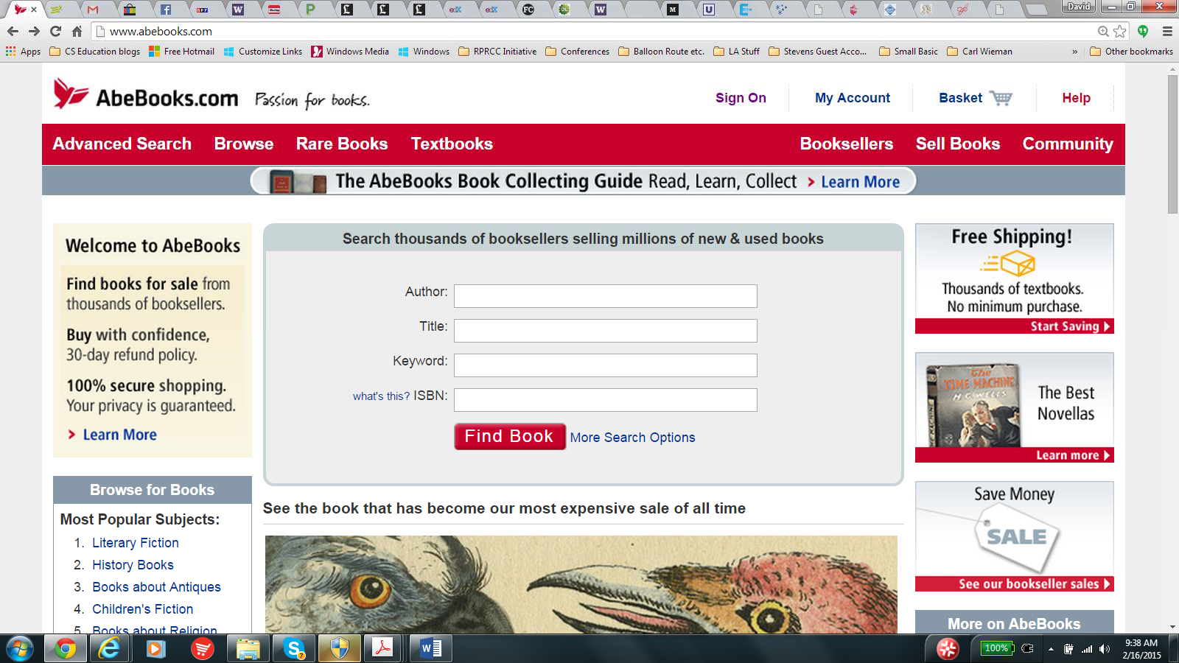
Create a New Account Use Case
Basic Course The user clicks on Sign On on AbeBooks.com’s home page
Note that the arrow isn’t absolutely necessary, but helps the reader find the relevant link, and the easier to read, the better.

Slide 25
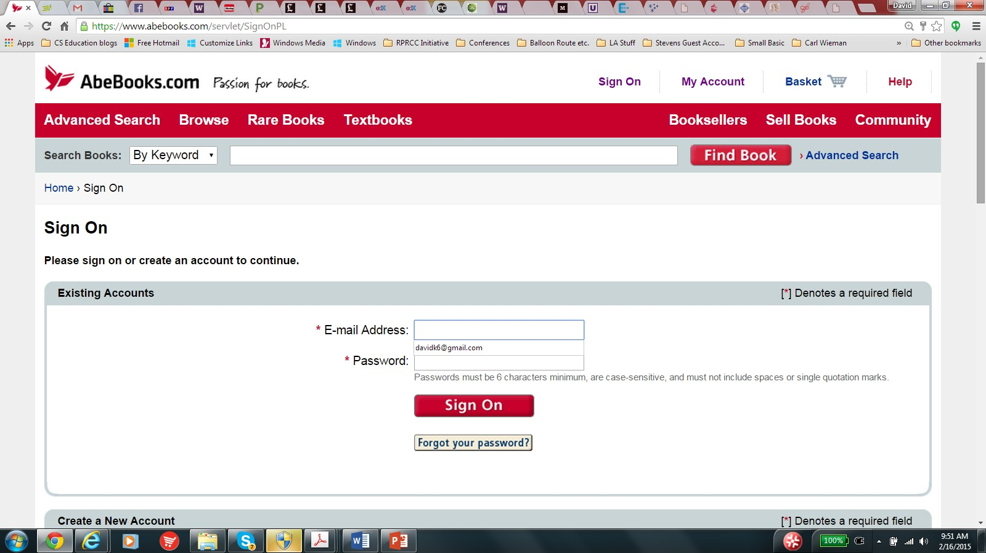
The system brings the user to the Sign On page

Slide 26
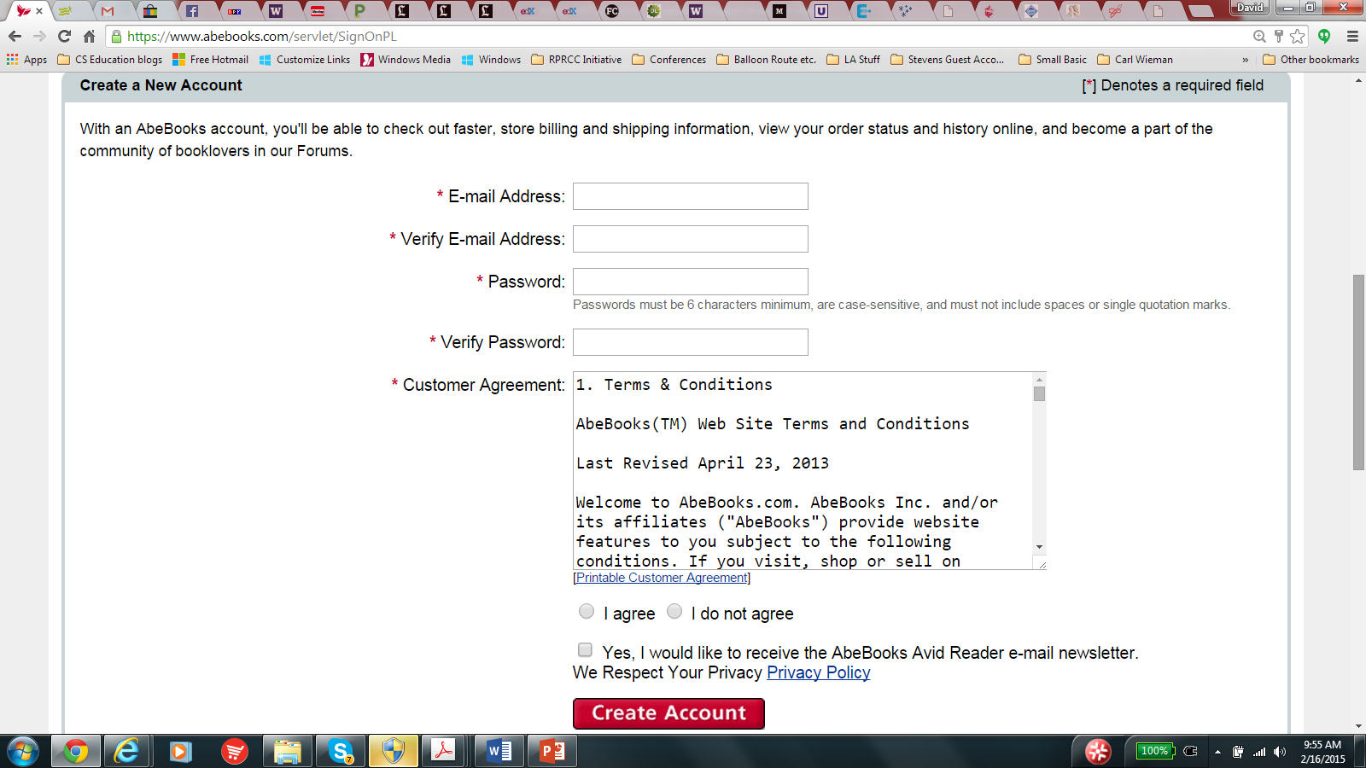
The user scrolls down to the Create a New Account part of the page

Slide 27
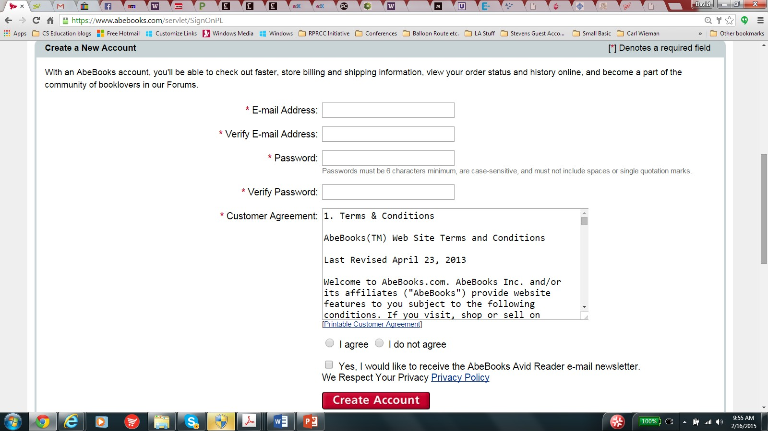
The user types an email address twice, the desired password, twice, and clicks on “I agree.” The user then clicks on Create Account. The system checks that the user has typed valid information into the email and password boxes, and has clicked on “I agree,” and returns the user to the home page.

Slide 28
If the user clicks on [Printable Customer Agreement], the system shows the user a printable copy of the Customer Agreement.

Slide 29

AbeBooks:.com - Printable Customer Agreement - GoogleChrome
...
,,_·-z-
,_
-
13 https:f/www.abebooks.com/docs/Legal/customerAgreementPrintable.shtml
I
Terms & Conditions
Abe BooksTM Web Site Terms and Conditions
Last Revised April 23, 2013
Welcome to AbeBooks .com.AbeBooksInc. and/or its affiliates ("AbeBooks") provide website features to you subject to the following conditions. If you visit,shop or sell on AbeBooks.com (the "Web Site"),you accept these conditions.Please read them carefully.
PRIVACY
Please review our Privacy & Security Notice,which also governs your visit to the Web Site,to understand our practices.
THE A BEBOOKS CUSTOMER AGREEMENT
These Terms and Conditions supplement the AbeBooks Customer Agreement ,which applies to registered AbeBooks customers. The AbeBooks Customer Agreement may be viewed by clicking here.
YO UR ACCOUNT
If you use the Web Site,you are responsible for maintaining the confidentiality of your account and password and for restricting access to your computer, and you agree to accept
respons bility for all activities that occur under your account or password. If you are under 19,you may use AbeBooks.com only with involvement of a parent or guardian. AbeBooks reserves the right to refuse service ,terminate accounts, remove or edit content,or cancel orders in its sole discretion .
DISCLAIMER
THE WEB SITE AND ALL INFORMATION,CONTENT, MATERIALS, PRODUCTS (INCLUDING SOFTWARE) AND SERVICES INCLUDED ON OR OTHERWISE MADE AVAILABL E TO YOU THROUGH THE WEB SITE AR E PROVIDED BY ABEBOOKS ON AN "AS IS" AND "AS AVAILABL E" BASIS, UNLESS OTHERW ISE SPECIFIED IN WR ITING. ABEBOOKS MAKES NO REPRESENTATIONS OR WARRANTIES OF ANY KIND, WHETHER EXPRESS OR IMPLIED, AS TO THE OPERATION OF THE WEB SITE OR THE INFORMATION , CONTENT,
MATERIALS, PRODUCTS (INCLUDING SOFTWAR E) OR SERVICES INCLUDED OR OTHERWISE MADE AVAILABLE TO YOU TO YOU THROUGH THE WEB SITE, UNLESS OTHERWISE SPECIFIED IN WR ITING.YOU EXPRESSLY AGR EE THAT YOUR USE OF THE WEB SITE IS AT YOUR SOLE RISK.
TO THE FULL EXTENT PERMISSIBLE BY APPLICABLE LAW,ABEBOOKS DISCLAIMS ALL WARRANTIES, EXPR ESS OR IMPLIED, INCLUDING, BUT NOT LIMITED TO, IMPLIED

Slide 30
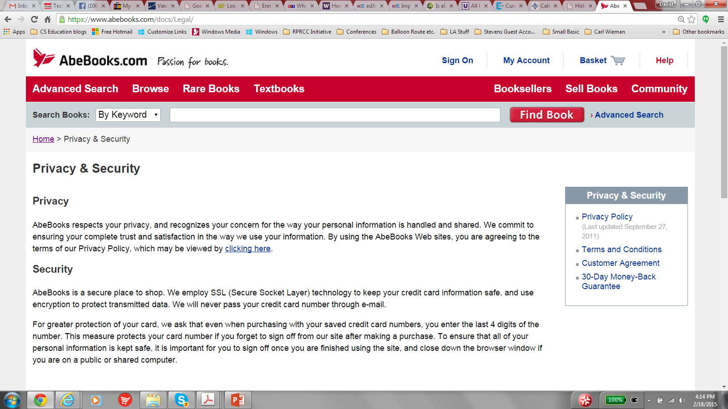
If the user clicks on Privacy Policy, the system shows the user abebooks.com’s privacy policy.

Slide 31
If the user clicks on Yes, “I would like to receive the AbeBooks Avid Reader e‐mail newsletter,” AbeBooks.com periodically sends the user the indicated newsletter.

Slide 32
Create a New Account Use Case
Alternate Course
If the user has not typed anything into one or more of the email or password boxes, has typed invalid information into one of these boxes, has not clicked on “I agree,” or has clicked on “I do not agree,” the system returns an error message that enables the user to go back to the Sign On/Create Account page and correct the error(s)

Slide 33
Homework
Construct the GUI prototype for abebooks.com’s version of the Internet Bookstore’s Log In use case.

